Slide 1

XClarity One Transition Roadmap & Migration Toolkit
April 2026
2026 Lenovo. All rights reserved.

Slide 2
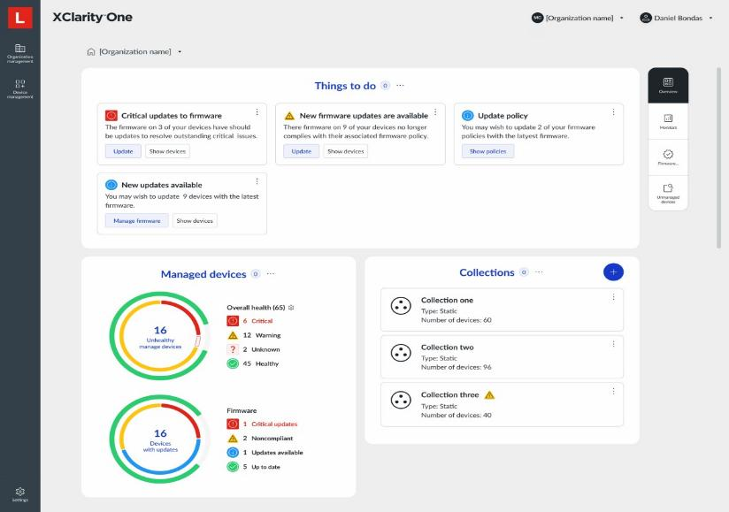
XClarity One
Simplified IT Operations
With XClarity One you can Simplify IT Operations, Secure your infrastructure, and Scale your success with unparalleled ease and confidence!
Manage your environment, not your tools
Security
Simplicity
Scalability
Efficiency
Reliability
Built on Zero Trust with MFA for better protection
Intuitive interfaces and automation reduce complexity
Cloud deployment allows flex up and down on demand
Optimized utilization lowers costs and environmental impact
Continuous monitoring and self-healing capabilities ensure uptime

Slide 3
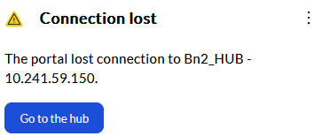
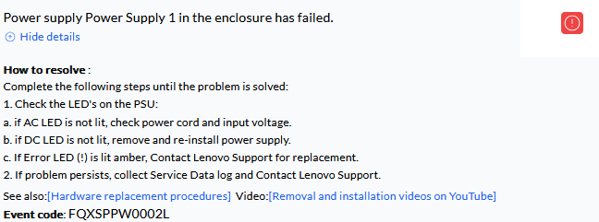
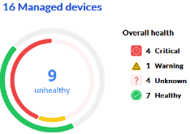
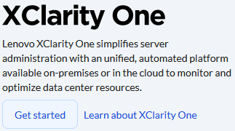
Lenovo XClarity One – Less Complexity, More Control
The right information at the right time
Turn data into information by showing the right things, at the right time
Lead users to deeper levels of information and offer solutions to correct their issues
Add extra knowledge from Lenovo Smarter Support, with AI insights to drive a deeper experience
Users feel empowered and informed, rather than overwhelmed by data
Things To Do
Focus on the
important things without being distracted
Guided Problem solving
Logically drill down to understand and solve issues
Quick Status Overview
Get a quick view of your environment to spot problems or just feel good!
Information on the move
Login to native Cloud, Mobile App*, or forward events to stay informed
*Future Function

Slide 4
Lenovo XClarity One – Flexible Deployment
Flexible Deployment
Users interact with the central XClarity One Portal
Devices interact with distributed XClarity One Hubs
Deploy them in a way that works for you
Scale up with more Hubs as your environment grows
Lenovo Hosted Hybrid Cloud
Lenovo hosted Cloud Portal +
On Prem or self hosted Hub
Self Hosted Hybrid Cloud*
Self hosted Cloud Portal +
On Prem or self hosted Hub
On Premise with internet
On Prem Portal + Hub
with internet updates
On Premise air-gapped
On Prem Portal + Hub
in a highly secure solution
Lenovo Cloud Services
Lenovo Cloud Services
Lenovo Cloud Services
Lenovo Cloud Services
cloud
cloud
XClarity One Portal
XClarity One Portal
on-prem
on-prem
Lenovo managed
User managed
XClarity One Portal
XClarity One Portal
cloud
cloud
cloud or on-prem
cloud or on-prem
XClarity One Hub
XClarity One Hub
XClarity One Hub
XClarity One Hub
on-prem
on-prem
Managed Device
Managed Device
Managed Device
Managed Device
*Future Function

Slide 5



Lenovo XClarity One – Security
Secure by design
Data is the modern currency.
Keeping it secure is a guiding XClarity One principle, even before a line of code is written
Portal to Hub link
Devices don’t all talk through the firewall reducing the attack surface
Certified Approach
ISO 27001 and SOC 2
certification
Known Data Flows
Be confident of where your data is and who can access it
hybrid cloud
deployment
cloud services
portal
firewall
Hub(s)
devices

Slide 6
What is Changing
Lenovo is transitioning customers from XClarity Administrator (LXCA) to XClarity One (XC1)
Our legacy offering LXCA remains supported, but it’s in maintenance mode!
All innovation, roadmap investment, and integrations are focused on XClarity One
Why Lenovo is making this shift
  Customers demand: Hybrid and on‑prem flexibility
  Centralized management across sites
  Proactive / predictive support
  Simplified licensing and lifecycle clarity
  XClarity One delivers: Unified platform (evolution beyond LXCA/LXCO)
  Hybrid cloud or fully on‑prem deployment
  Smarter support and analytics‑driven operations
  Future‑proof architecture and APIs
Key positioning
  A guided evolution to Lenovo’s strategic platform
  Customer choice on timing and deployment model
  Existing licensing will work with XC1 ( On-premise working, Cloud coming soon)

Slide 7
Quote layout
LXCA/LXCO Transition Timelines
2025 | 2026 | 2027
Aug | Sep | Oct | Nov | Dec | Jan | Feb | Mar | Apr | May | Jun | Jul | Aug | Sep | Oct | Nov | Dec | Jan | Feb | Mar | Apr | May | Jun
25.2
25.3
26.1
26.2
26.3
26.4
27.1
27.2
1 year
Free Trial
announced
Public Announce
End of
Sales
(EOL)
End
Of
Support
(EOS)
DCSC default
changes
1 Year free trial PN available now in DCSC for a limited time only
Revamped Cloud and On-Premise Trial capabilities coming in March 2026
LXCA/ LCXO EOL June 2026
LXCA/ LCXO EOS June 2027
2026 Lenovo. All rights reserved.

Slide 8

Content and right table layout
FUTURE
  Partners, schedule an NDA call with your Lenovo Channel Team
MAR 2026
26.1
Full details on Highspot
  New Starter License and Standard License
  Refreshed Trial capabilities for Cloud and On Premise
  PowerShell SDK (phase 1)
  ServiceNow Integration (phase 1)
  Showing all warranties for a device
XClarity One Readiness Check
DEC 2025
25.3
Full details on Highspot
  On Premise without internet connection
  OS Deployment (phase 1)
  REST API (1st release)
  ISO and SOC 2 certs
  LDAP
XClarity One has added many capabilities with each release.
SEP 2025
25.2
Full details on Highspot
  On Premise support
  UI Improvements
  Device Settings (Config Patterns) added to templates
  Federation improvements
  Table filtering
2026 Lenovo. All rights reserved.

Slide 9



Top Customer Questions
Q. “Is XClarity One cloud‑only?”
A. No. XClarity One supports: Cloud‑hosted, Fully on‑premises with or without internet access
Q. “What happens to our XClarity Pro / Orchestrator licenses?”
A. Existing customer entitlements are honored. XClarity One Standard consolidates Pro + Orchestrator functionality into a single license
Q. “Are we investing in a dead end if we stay on LXCA?”
A. LXCA is supported but no longer strategic. New capabilities, APIs, and integrations are delivered through XClarity One
Q. “Will LXCA continue to function after support ends?”
A. After the support period ends, LXCA will continue to operate normally. Lenovo will no longer provide updates, fixes, or technical support, but your license remains valid.
2026 Lenovo. All rights reserved.
9
9

Slide 10
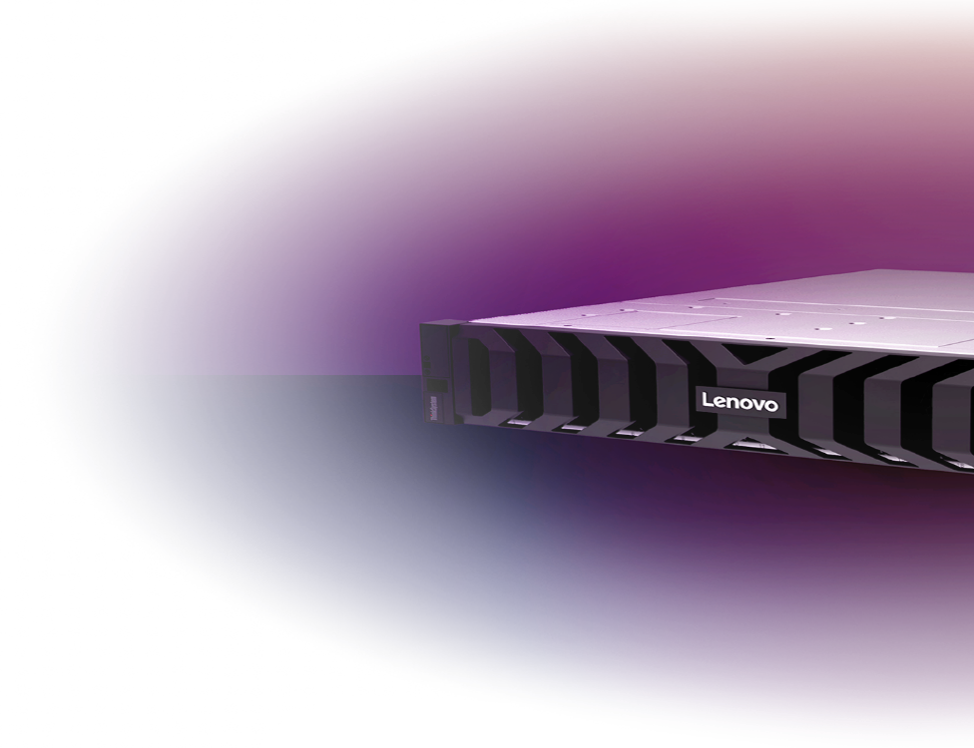
License Migration
Cloud
XClarity One in Cloud will automatically see Pro Licenses when an organization is registered with the matching customer number
XClarity Pro
Advanced features, Support
Pro licenses will be duplicated by LKMS into XClarity One Standard licenses on a 1:1 basis
XClarity One – Standard
Analytics, Advanced Features, Support
XClarity One end dates will match the existing entitlement dates of XClarity Pro and XClarity Orchestrator
XClarity Orchestrator
Analytics and Advanced Features
Orchestrator licenses will not migrate. The XClarity Pro to XClarity One Standard migration delivers Orchestrator equivalency
On-Premises
Recognizes Pro licenses or LKMS duplicates as XClarity One licenses (but not both at the same time!)
2026 Lenovo. All rights reserved.

Slide 11
License Migration cont.
Lenovo
Cloud Services
Lenovo
Cloud Services
Cloud
XClarity One in Cloud will automatically see Pro Licenses when an organization is registered with the matching customer number. If you purchased licenses before requesting an organization, the organization request is approved immediately, and the licenses are automatically applied to the organization.
Recognizes Pro licenses or LKMS duplicates as XClarity One licenses (but not both at the same time!)
A license for XClarity One needs to be downloaded and imported in order to activate functions in the portal. Either LXP or XC1 is accepted but not both.
On-Premises
Cloud
On-prem
XClarity One
Portal
XClarity One
Portal
Cloud
On-prem
Secure
hub 1
Secure
hub 1
Secure
hub 1
Secure
hub 1
Secure
hub 2
Secure
hub N
Cloud hybrid
On-premises
2026 Lenovo. All rights reserved.

Slide 12
Migration Tool from LXCA
Key Functions
Supported Devices Licenses Static Groups Call home tickets Firmware policies Configuration patterns Up to 500 endpoints |  | Existing
Call home settings Awareness of portal managed devices |  | March
Dynamic groups 1000 endpoint support Post migration user report |  | June
LDAP user groups Call home config for groups Feature complete! |  | September
The Migration Tool is initiated within XClarity One
The tool can not migrate
XClarity Pro Enterprise licenses
Firmware packages and OS Images
Events and Alerts
Devices with encapsulation enabled
12

Slide 13
Migration Tool Detail
BEFORE PROCEEDING
Ensure that the XClarity Administrator instance is at v4.3.4 or later.
Ensure that the XClarity Administrator instance has valid licenses for each managed device.
Back up the XClarity Administrator system data and settings and then save the backup to your local system (see Backing up XClarity Administrator in the XClarity Administrator online documentation).
Ensure that you are an organization owner in the organization.
Ensure that your XClarity Administrator user account has lxc-supervisor or lxc-admin privileges.
Ensure that the hub that you want to use to manage the new devices is connected to XClarity One and is in a healthy state. The hub must be Lenovo XClarity One Hub v1.5 or later.
You can migrate an existing Lenovo XClarity Administrator v4.3.4 or later instance to Lenovo XClarity One and a connected Lenovo XClarity One Hub v1.5 or later.
This transfers management of the devices to the target hub and imports artifacts such as firmware policies, device-settings configurations (configuration patterns), groups, service tickets, and XClarity Pro licenses into XClarity One.
13

Slide 14

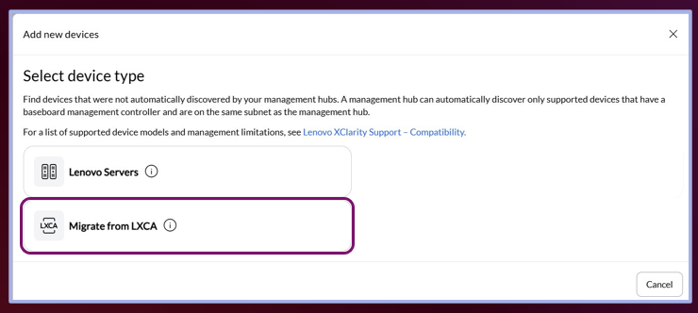
Migration Tool Detail
When the wizard opens, select Migrate from LXCA for the device type, and then follow the steps in the wizard to complete the process.
3
1
Click the Device management view
2
Click Unmanaged Devices in the context menu, Then click the Add icon above the table
14

Slide 15
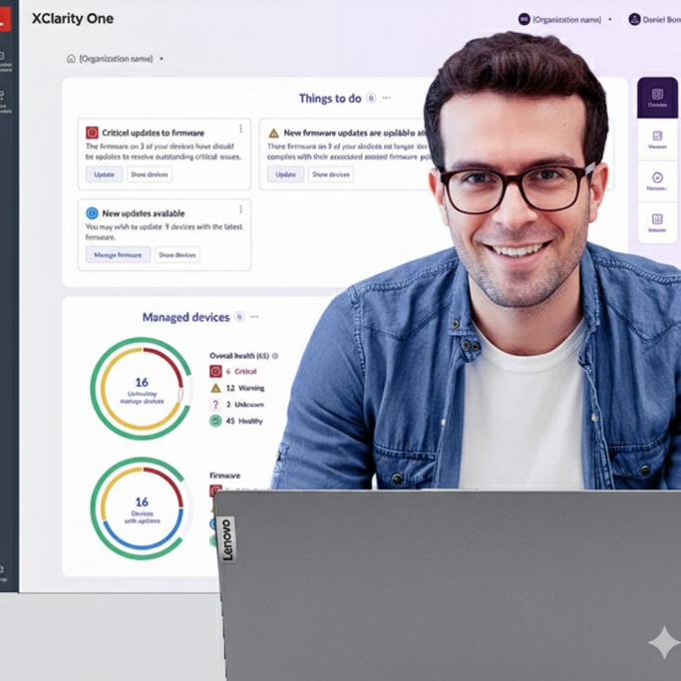
Conversation Do’s and Don’ts
Do
Lead with choice, flexibility, and protection of customer investment
Position XC1 as evolution, not replacement
Encourage trials and pilots aligned to customer readiness
Don’t
Quote internal EOL/EOS target dates
Say LXCA is “end of life now”
Position XC1 as mandatory or disruptive

Slide 16

Recommended Sales Conversation Flow
Acknowledge customer reality
(regulatory, uptime, investment protection)
Position XC1 as evolution, not replacement
Address on‑prem / internet concerns early
Reassure on licensing protection
Align migration timing to customer readiness
Offer XC1 trial (free trial is still available) or pilot

Slide 17

Revised Trial Procedures for Testing and Demos
On Premise
  Download XClarity One VM of your choice
  Set up as usual
  If no license are added the user is given 20 licenses for a 90-day period
  At the end of this period, if no licenses are added we will limit function…
  LINK
Cloud
  Visit xc1.Lenovo.com
  There will be a new option to setup a trial organization
  No customer number is needed
  The trial is limited to 2 hubs and 20 devices. Real devices can be added or Demo devices used
  After 90 days it will block login. It can be manually extended on request but otherwise it will be deleted
  LINK

Slide 18
Thanks
thanks

